Slide 1

FACULTY OF INFORMATION TECHNOLOGY
Fall,20202017
MAT 207- LINEAR ALGEBRA
Lecture 4 – Matrix Algebra
11/10/2021
Lecture 3 : Matrix Algebra
1

Slide 2

Content
1
Matrix Factorizations
2
Subspace of $ℝ^{n}$
3
Dimension and Rank
11/10/2021
Lecture 2 : Linear Equation in Linear Algebra
2

Slide 3
Matrix Factorizations
11/10/2021
Lecture 3: Matrix Algebra
1
Notes:
3

Slide 4
Matrix Factorizations
A factorization of a matrix A is an equation that expresses A as a product of two or more matrices.
Whereas matrix multiplication involves a synthesis of data (combining the effects of two or more linear transformations into a single matrix), matrix factorization is an analysis of data.

Slide 5
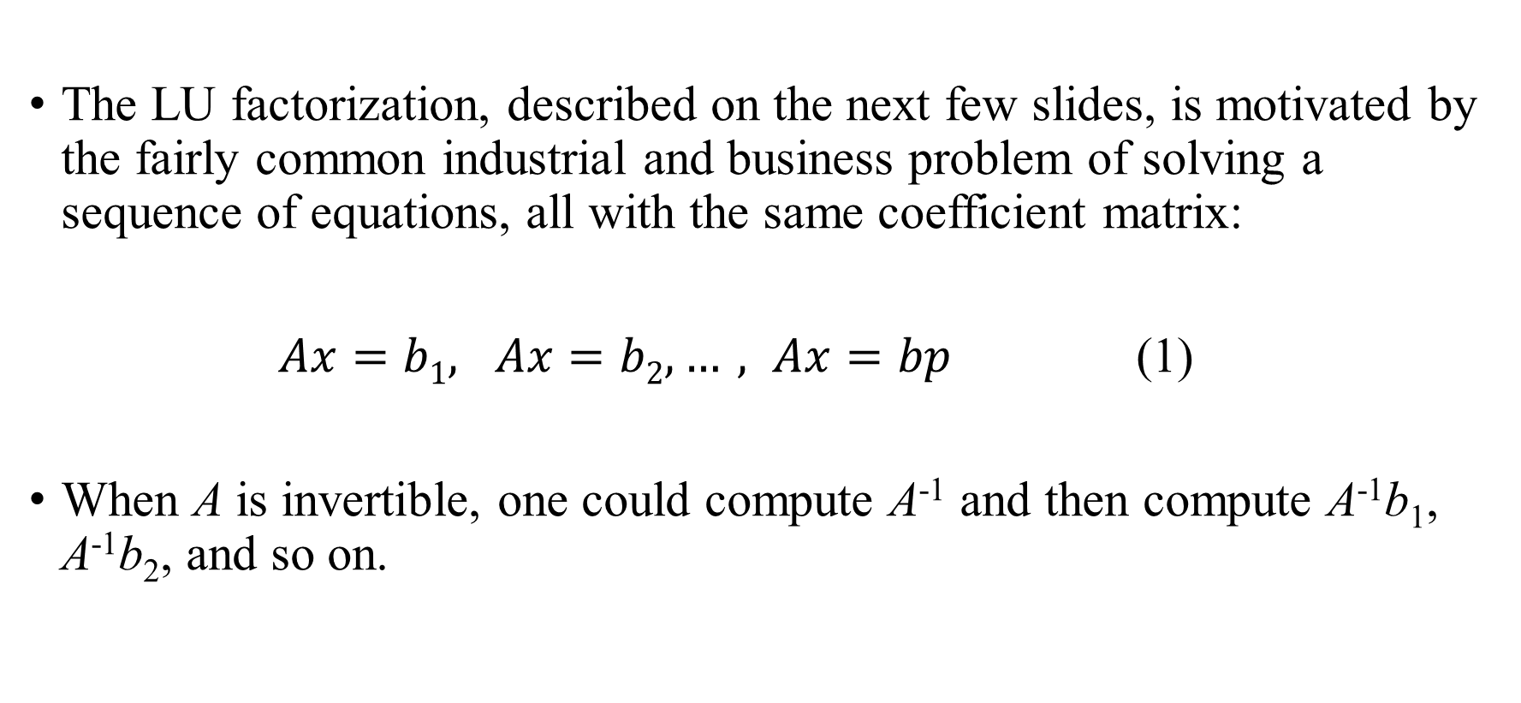
THE LU FACTORIZATION
The LU factorization, described on the next few slides, is motivated by the fairly common industrial and business problem of solving a sequence of equations, all with the same coefficient matrix:
$Ax=b1, Ax=b2, …, Ax=bp$ (1)
When A is invertible, one could compute A⁻¹ and then compute A⁻¹b₁, A⁻¹b₂, and so on.

Slide 6
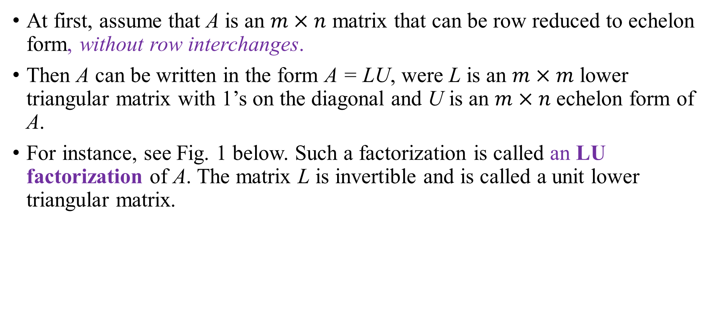
THE LU FACTORIZATION
At first, assume that A is an $m×n$ matrix that can be row reduced to echelon form, without row interchanges.
Then A can be written in the form A = LU, were L is an $m×m$ lower triangular matrix with 1’s on the diagonal and U is an $m×n$ echelon form of A.
For instance, see Fig. 1 below. Such a factorization is called an LU factorization of A. The matrix L is invertible and is called a unit lower triangular matrix.

Slide 7
THE LU FACTORIZATION
Before studying how to construct L and U, we should look at why they are so useful. When A = LU, the equation Ax = b can be written as L(Ux) = b.

Slide 8
THE LU FACTORIZATION
Writing y for Ux, we can find x by solving the pair of equations
First solve Ly = b for y, and then solve Ux = y for x. See Fig. 2 on the
next slide. Each equation is easy to solve because L and U are triangular.
Ly = b
Ux = y

Slide 9
THE LU FACTORIZATION

Slide 10
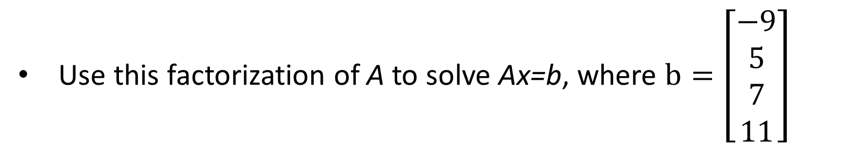
THE LU FACTORIZATION
Example 1 It can be verified that
Use this factorization of A to solve Ax=b, where $b=\left[\begin{aligned}−9 \\ 5 \\ 7 \\ 11\end{aligned}\right]$

Slide 11
THE LU FACTORIZATION
Then, for Ux = y, the “backward” phase of row reduction requires 4 divisions, 6 multiplications, and 6 additions.
Then, for Ux = y, the “backward” phase of row reduction requires 4 divisions, 6 multiplications, and 6 additions.

Slide 12
THE LU FACTORIZATION
For instance, creating the zeros in column 4 of [U y] requires 1 division in row 4 and 3 multiplication-addition pairs to add multiples of row 4 to the rows above.

Slide 13
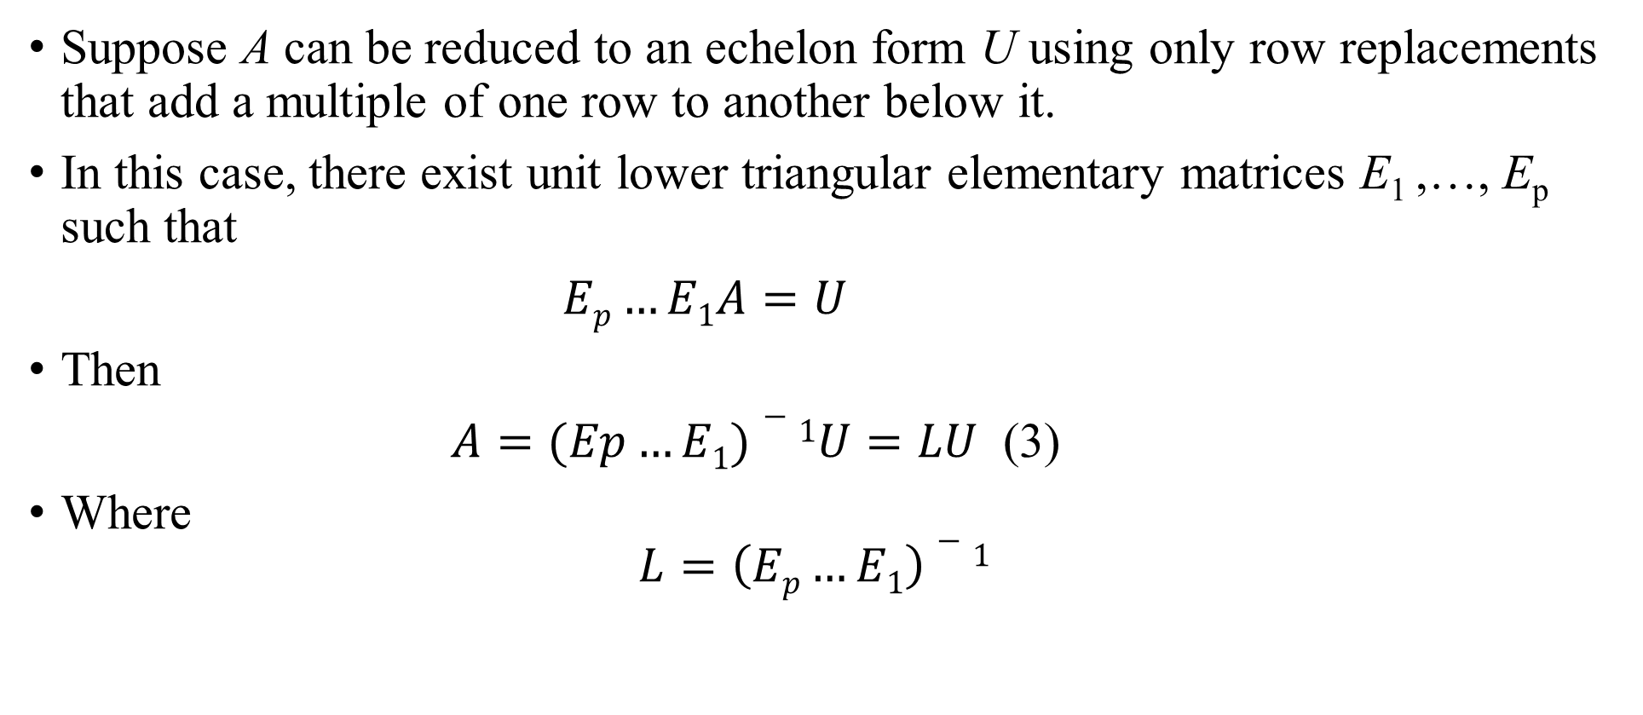
AN LU FACTORIZATION ALGORITHM
Suppose A can be reduced to an echelon form U using only row replacements that add a multiple of one row to another below it.
In this case, there exist unit lower triangular elementary matrices E₁ ,…, E_{p} such that
$Ep…E1A=U$
Then
$A=(Ep…E1)−1U=LU$ (3)
Where
$$L=\left(Ep…E1\right)−1$$

Slide 14
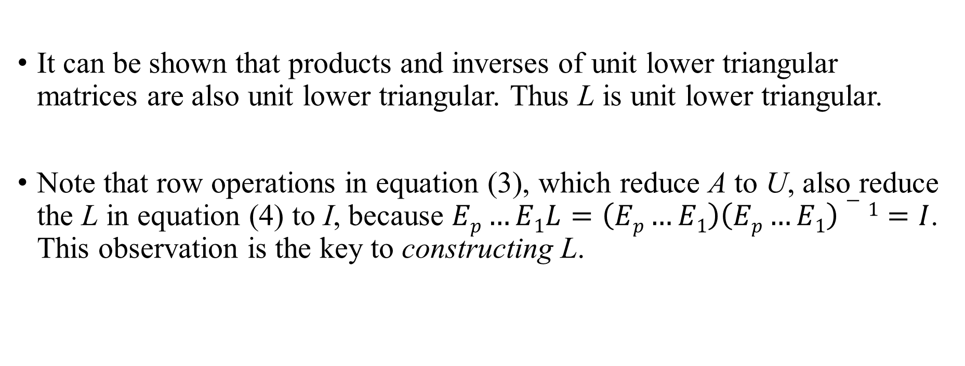
AN LU FACTORIZATION ALGORITHM
It can be shown that products and inverses of unit lower triangular matrices are also unit lower triangular. Thus L is unit lower triangular.
Note that row operations in equation (3), which reduce A to U, also reduce the L in equation (4) to I, because $Ep…E1L=\left(Ep…E1\right)\left(Ep…E1\right)−1=I$. This observation is the key to constructing L.

Slide 15
AN LU FACTORIZATION ALGORITHM
Algorithm for an LU Factorization
Reduce A to an echelon form U by a sequence of row replacement operations, if possible.
Place entries in L such that the same sequence of row operations reduces L to I.

Slide 16

AN LU FACTORIZATION ALGORITHM
Example 2 Find an LU factorization of
Solution Since A has four rows, L should be $4×4$. The first column of L is the first column of A divided by the top pivot entry:

Slide 17
AN LU FACTORIZATION ALGORITHM
Compare the first columns of A and L. The row operations that create zeros in the first column of A will also create zeros in the first column of L.
To make this same correspondence of row operations on A hold for the rest of L, watch a row reduction of A to an echelon form U. That is, highlight the entries in each matrix that are used to determine the sequence of row operations that transform A onto U.

Slide 18
AN LU FACTORIZATION ALGORITHM
The highlighted entries above determine the row reduction of A to U. At each pivot column, divide the highlighted entries by the pivot and place the result onto L:
An easy calculation verifies that this L and U satisfy LU = A.

Slide 19

SUBSPACES OF $ℝ^{n}$

Slide 20
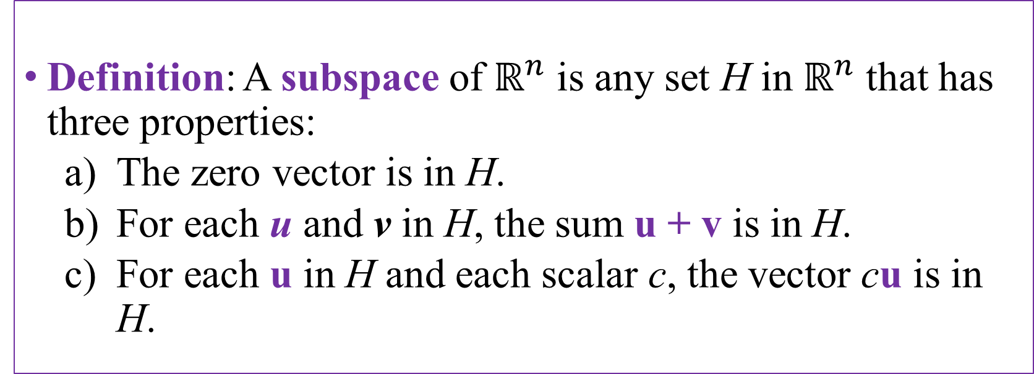
SUBSPACES OF $ℝ^{n}$
Definition: A subspace of $ℝ^{n}$ is any set H in $ℝ^{n}$ that has three properties:
The zero vector is in H.
For each u and v in H, the sum u + v is in H.
For each u in H and each scalar c, the vector cu is in H.

Slide 21
SUBSPACES OF $ℝ^{n}$
A plane through the origin is the standard way to visualize the subspace in Example 1 on the next slide. See Fig. 1 below:

Slide 22
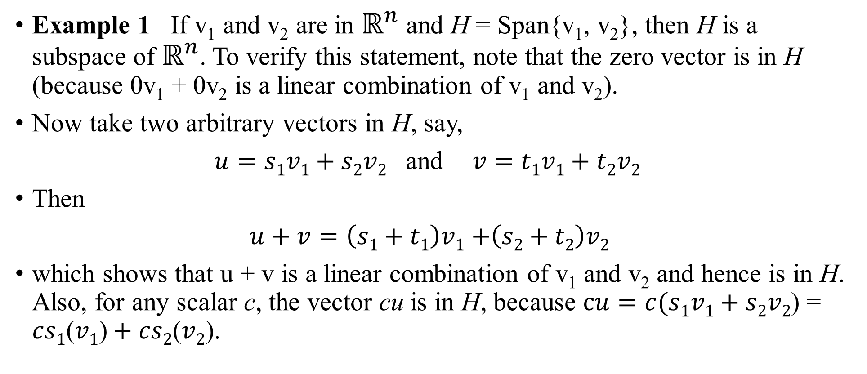
SUBSPACES OF $ℝ^{n}$
Example 1 If v₁ and v₂ are in $ℝ^{n}$ and H = Span{v₁, v₂}, then H is a subspace of $ℝ^{n}$. To verify this statement, note that the zero vector is in H (because 0v₁ + 0v₂ is a linear combination of v₁ and v₂).
Now take two arbitrary vectors in H, say,
$u=s1v1+s2v2$ and$v=t1v1+t2v2$
Then
$u+v=\left(s1+t1\right)v1$ $+\left(s2+t2\right)v2$
which shows that u + v is a linear combination of v₁ and v₂ and hence is in H. Also, for any scalar c, the vector cu is in H, because $cu=c(s1v1+s2v2$) = $cs1\text{(}v1\text{)}+cs2\text{(}v2\text{)}$.

Slide 23
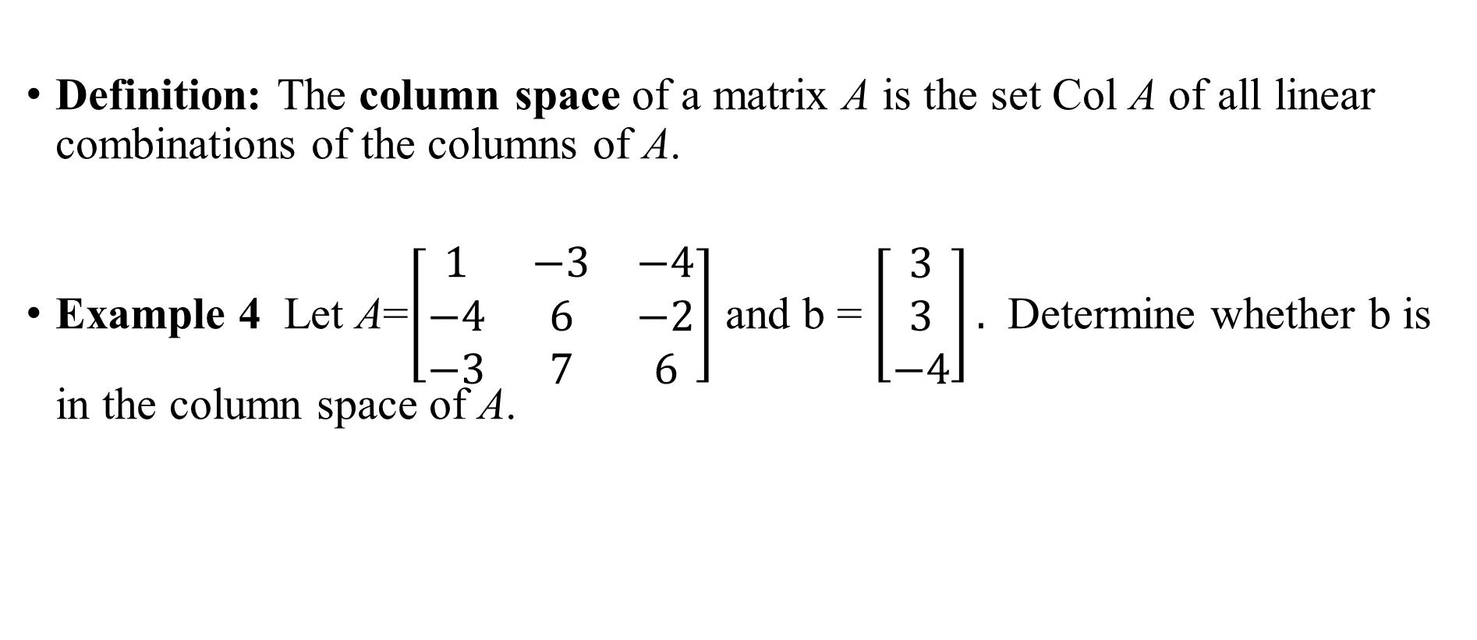
COLUMN SPACE AND NULL SPACE OF A MATRIX
Definition: The column space of a matrix A is the set Col A of all linear combinations of the columns of A.
Example 4 Let A=$\left[\begin{matrix}1 & −3 & −4 \\ −4 & 6 & −2 \\ −3 & 7 & 6\end{matrix}\right]$ and b = $\left[\begin{matrix}3 \\ 3 \\ −4\end{matrix}\right].$ Determine whether b is in the column space of A.

Slide 24
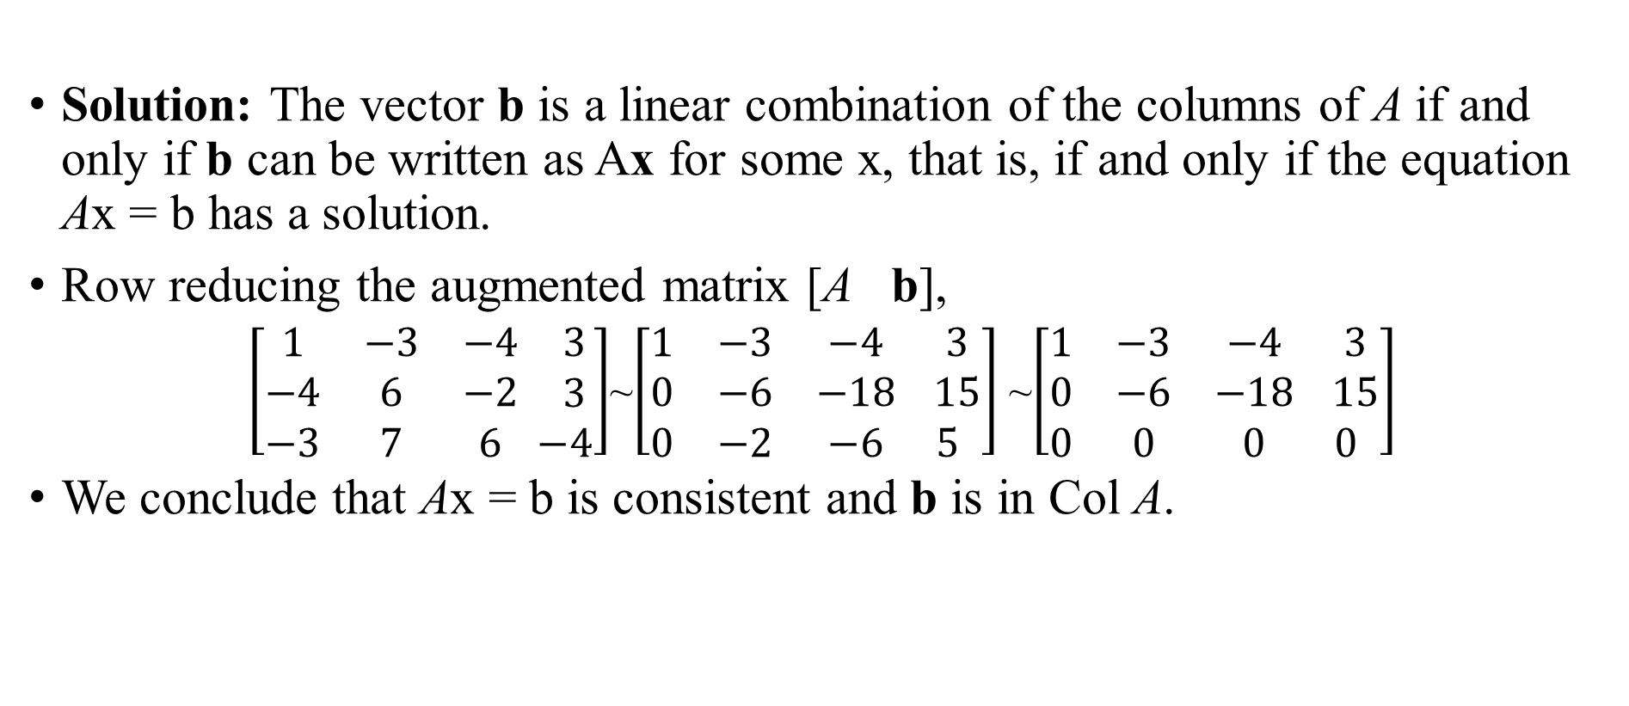
COLUMN SPACE AND NULL SPACE OF A MATRIX
Solution: The vector b is a linear combination of the columns of A if and only if b can be written as Ax for some x, that is, if and only if the equation Ax = b has a solution.
Row reducing the augmented matrix [A b],
$\left[\begin{matrix}1 & −3 & −4 \\ −4 & 6 & −2 \\ −3 & 7 & 6\end{matrix} \begin{matrix} 3 \\ 3 \\ −4\end{matrix}\right]$~$\left[\begin{matrix}1 & −3 & −4 \\ 0 & −6 & −18 \\ 0 & −2 & −6\end{matrix} \begin{matrix} 3 \\ 15 \\ 5\end{matrix}\right]$ ~$\left[\begin{matrix}1 & −3 & −4 \\ 0 & −6 & −18 \\ 0 & 0 & 0\end{matrix} \begin{matrix} 3 \\ 15 \\ 0\end{matrix}\right]$
We conclude that Ax = b is consistent and b is in Col A.

Slide 25
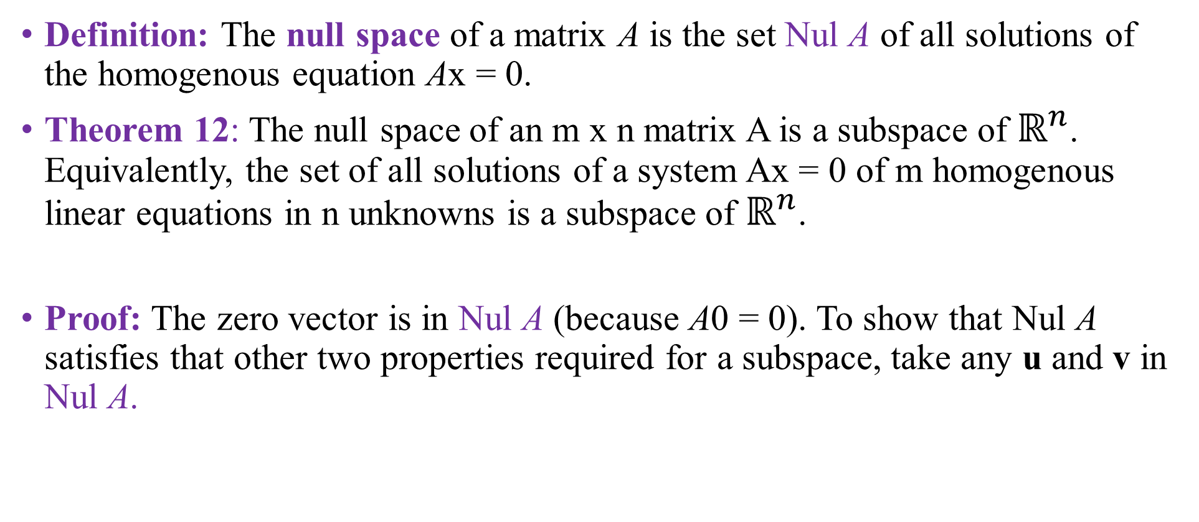
COLUMN SPACE AND NULL SPACE OF A MATRIX
Definition: The null space of a matrix A is the set Nul A of all solutions of the homogenous equation Ax = 0.
Theorem 12: The null space of an m x n matrix A is a subspace of $ℝ^{n}$. Equivalently, the set of all solutions of a system Ax = 0 of m homogenous linear equations in n unknowns is a subspace of $ℝ^{n}$.
Proof: The zero vector is in Nul A (because A0 = 0). To show that Nul A satisfies that other two properties required for a subspace, take any u and v in Nul A.

Slide 26
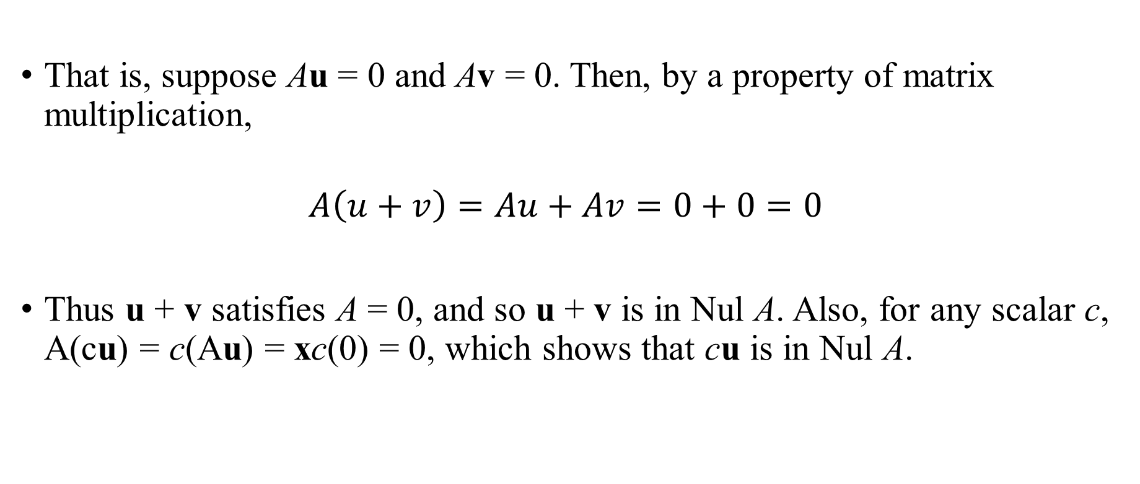
COLUMN SPACE AND NULL SPACE OF A MATRIX
That is, suppose Au = 0 and Av = 0. Then, by a property of matrix multiplication,
$$A\left(u+v\right)=Au+Av=0+0=0$$
Thus u + v satisfies A = 0, and so u + v is in Nul A. Also, for any scalar c, A(cu) = c(Au) = xc(0) = 0, which shows that cu is in Nul A.

Slide 27
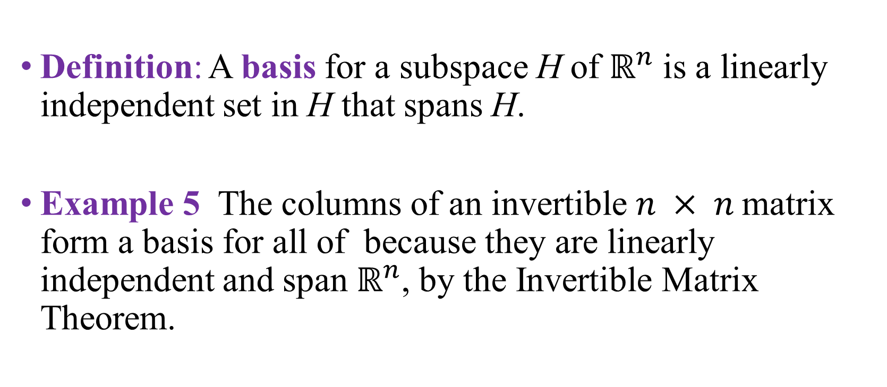
BASIS FOR A SUBSPACE
Definition: A basis for a subspace H of $ℝ^{n}$ is a linearly independent set in H that spans H.
Example 5 The columns of an invertible $n × n$matrix form a basis for all of because they are linearly independent and span $ℝ^{n}$, by the Invertible Matrix Theorem.

Slide 28
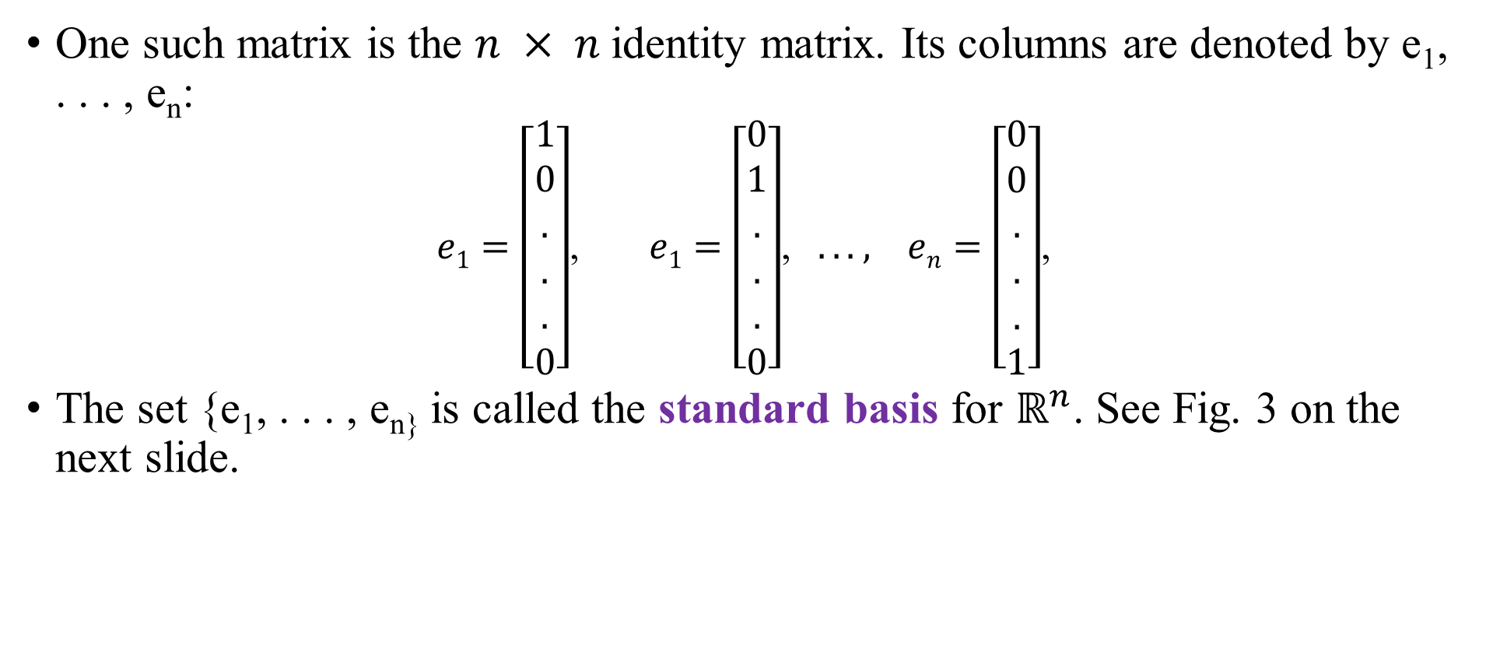
BASIS FOR A SUBSPACE
One such matrix is the $n × n$identity matrix. Its columns are denoted by e₁, . . . , e_{n}:
$e1=\left[\begin{aligned}1 \\ 0 \\ . \\ . \\ . \\ 0\end{aligned}\right]$, $e1=\left[\begin{aligned}0 \\ 1 \\ . \\ . \\ . \\ 0\end{aligned}\right]$, $. . . , en=\left[\begin{aligned}0 \\ 0 \\ . \\ . \\ . \\ 1\end{aligned}\right]$,
The set {e₁, . . . , e_{n}} is called the standard basis for $ℝ^{n}$. See Fig. 3 on the next slide.

Slide 29
Theorem 13: The pivot columns of a matrix A form a basis for the column space of A.

Slide 30
Dimension And Rank

Slide 31
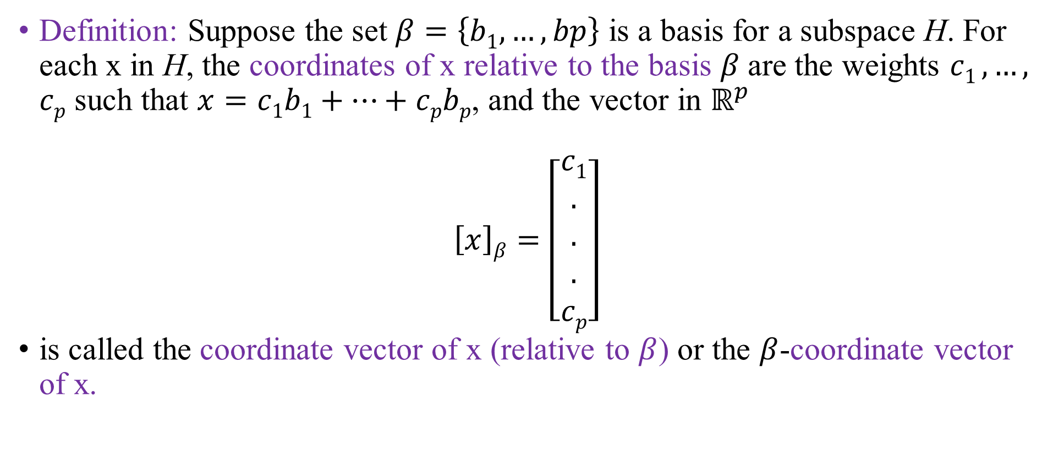
COORDINATE SYSTEMS
Definition: Suppose the set $β=\left\{b1,…,bp\right\}$ is a basis for a subspace H. For each x in H, the coordinates of x relative to the basis $β$are the weights $c1 ,…,$ $cp$ such that $x=c1b1+…+$ $cpbp$, and the vector in $ℝ^{p}$
$$\left[x\right]β=\left[\begin{aligned}c1 \\ . \\ . \\ . \\ cp\end{aligned}\right]$$
is called the coordinate vector of x (relative to $β$) or the $β$-coordinate vector of x.

Slide 32
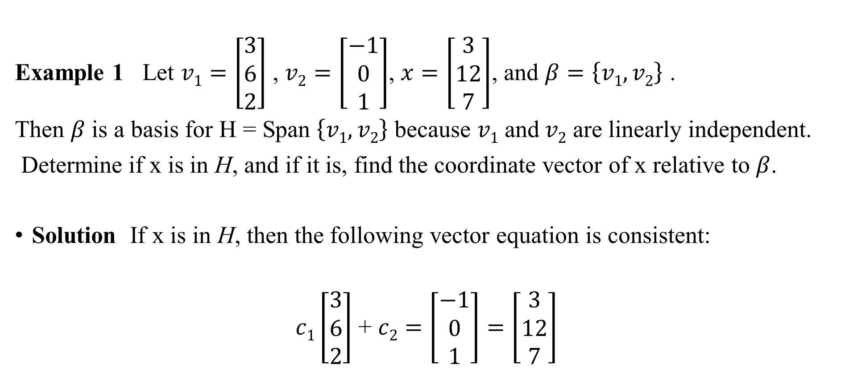
COORDINATE SYSTEMS
Example 1 Let $v1=\left[\begin{aligned}3 \\ 6 \\ 2\end{aligned}\right]$ , $v2=\left[\begin{aligned}−1 \\ 0 \\ 1\end{aligned}\right]$, $x=\left[\begin{aligned}3 \\ 12 \\ 7\end{aligned}\right]$, and $β=\left\{v1,v2\right\}$ .
Then $β$ is a basis for H = Span $\left\{v1,v2\right\}$ because $v1$ and$v2$ are linearly independent.
Determine if x is in H, and if it is, find the coordinate vector of x relative to $β$.
Solution If x is in H, then the following vector equation is consistent:
$c1\left[\begin{aligned}3 \\ 6 \\ 2\end{aligned}\right]$ + $c2=\left[\begin{aligned}−1 \\ 0 \\ 1\end{aligned}\right]=\left[\begin{aligned}3 \\ 12 \\ 7\end{aligned}\right]$

Slide 33
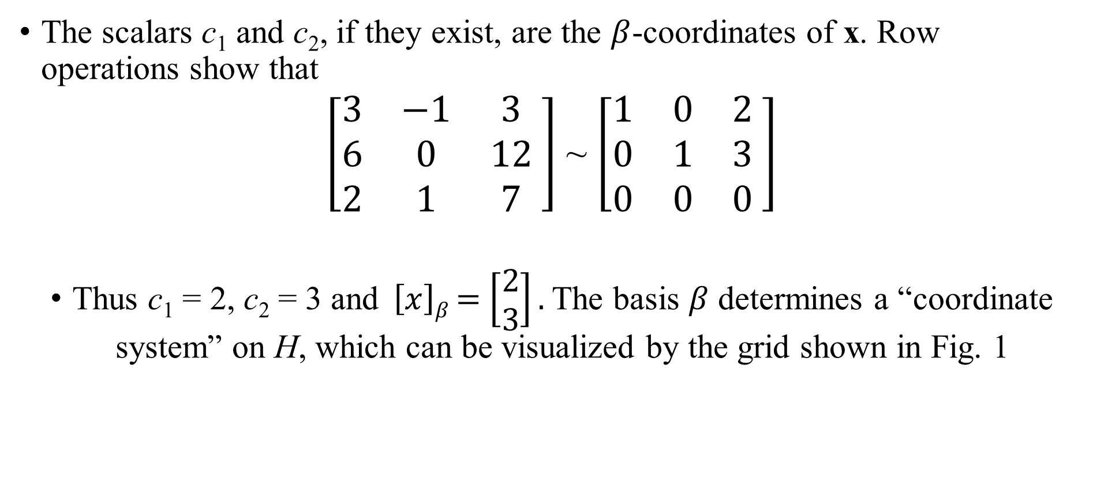
COORDINATE SYSTEMS
The scalars c₁ and c₂, if they exist, are the $β$-coordinates of x. Row operations show that
$\left[\begin{matrix}3 & −1 & 3 \\ 6 & 0 & 12 \\ 2 & 1 & 7\end{matrix} \right]$ ~ $\left[\begin{matrix}1 & 0 & 2 \\ 0 & 1 & 3 \\ 0 & 0 & 0\end{matrix} \right]$
Thus c₁ = 2, c₂ = 3 and $\left[x\right]β$ $=$ $\left[\begin{aligned}2 \\ 3\end{aligned}\right].$The basis $β$ determines a “coordinate system” on H, which can be visualized by the grid shown in Fig. 1

Slide 34
COORDINATE SYSTEMS

Slide 35
THE DIMESION OF A SUBSPACE
Definition: The dimension of a nonzero subspace H, denoted by dim H, is the number of vectors in any basis for H. The dimension of the zero subspace {0} is defined to be zero
Definition: The rank of a matrix A, denoted by rank A, is the dimension of the column space of A.

Slide 36
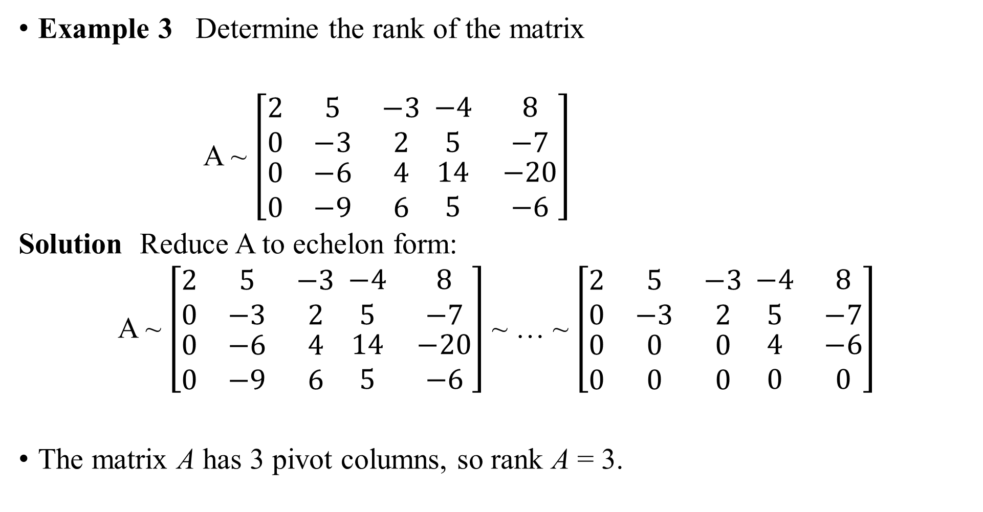
THE DIMESION OF A SUBSPACE
Example 3 Determine the rank of the matrix
A ~ $\left[\begin{matrix}2 & 5 & −3 \\ 0 & −3 & 2 \\ \begin{aligned}0 \\ 0\end{aligned} & \begin{aligned}−6 \\ −9\end{aligned} & \begin{aligned}4 \\ 6\end{aligned}\end{matrix} \begin{matrix}−4 & 8 \\ 5 & −7 \\ \begin{aligned}14 \\ 5\end{aligned} & \begin{aligned}−20 \\ −6\end{aligned}\end{matrix}\right]$
Solution Reduce A to echelon form:
A ~ $\left[\begin{matrix}2 & 5 & −3 \\ 0 & −3 & 2 \\ \begin{aligned}0 \\ 0\end{aligned} & \begin{aligned}−6 \\ −9\end{aligned} & \begin{aligned}4 \\ 6\end{aligned}\end{matrix} \begin{matrix}−4 & 8 \\ 5 & −7 \\ \begin{aligned}14 \\ 5\end{aligned} & \begin{aligned}−20 \\ −6\end{aligned}\end{matrix}\right]$ ~ … ~ $\left[\begin{matrix}2 & 5 & −3 \\ 0 & −3 & 2 \\ \begin{aligned}0 \\ 0\end{aligned} & \begin{aligned}0 \\ 0\end{aligned} & \begin{aligned}0 \\ 0\end{aligned}\end{matrix} \begin{matrix}−4 & 8 \\ 5 & −7 \\ \begin{aligned}4 \\ 0\end{aligned} & \begin{aligned}−6 \\ 0\end{aligned}\end{matrix}\right]$
The matrix A has 3 pivot columns, so rank A = 3.
Pivot columns

Slide 37
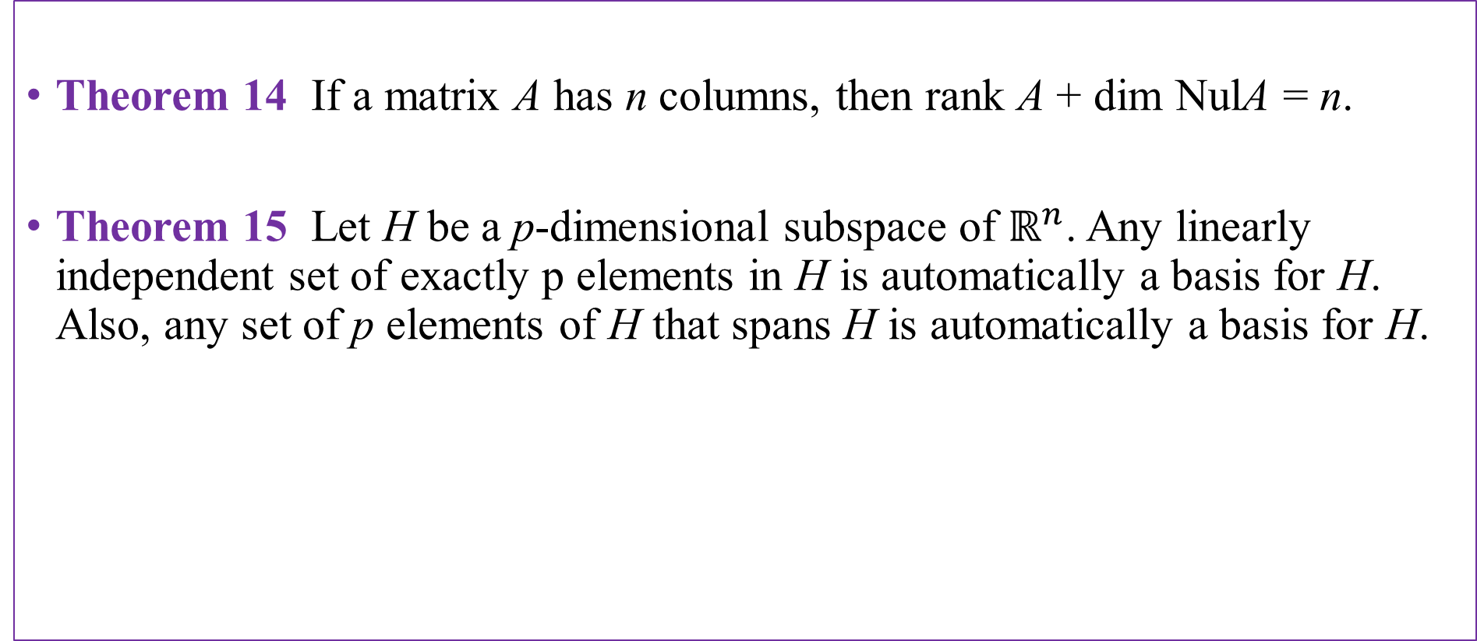
THE DIMESION OF A SUBSPACE
Theorem 14 If a matrix A has n columns, then rank A + dim NulA = n.
Theorem 15 Let H be a p-dimensional subspace of $ℝ^{n}$. Any linearly independent set of exactly p elements in H is automatically a basis for H. Also, any set of p elements of H that spans H is automatically a basis for H.

Slide 38
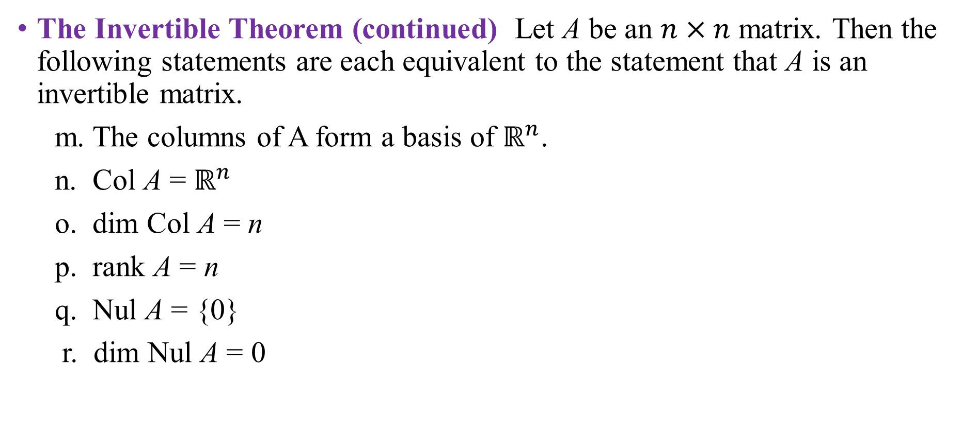
RANK AND THE INVERTIBLE MATRIX THEOREM
The Invertible Theorem (continued) Let A be an $n×n$ matrix. Then the following statements are each equivalent to the statement that A is an invertible matrix.
m. The columns of A form a basis of $ℝ^{n}$.
n. Col A = $ℝ^{n}$
o. dim Col A = n
p. rank A = n
q. Nul A = {0}
r. dim Nul A = 0

Slide 39
Thank you for listening

